Slide 1
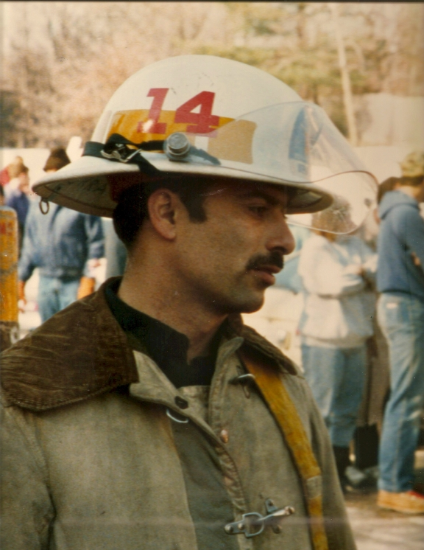
Leaders on Leadership
Deputy Chief James G. Yvorra (Circa 1987)
Examining Yvorra Leadership Development Foundation’s - 29 Years of Insight on Leadership
Michael S. Hildebrand, President
Yvorra Leadership Development Foundation 443-968-0862 │ www.yld.org
Updated 2017

Slide 2
Award recipients
from 23 different States
29 Years of Continuous Operation
YLD
DEMOGRAPHICS
Average Award Value is $2,500
Awarded $140,500 in Scholarships
“Most partnerships are based on working
toward goals, YLD’s is based on strengthening
each other.”
45% Firefighters
15% Lieutenants
Award Recipients 76% Male and 24% Female
92 Different Award Recipients

Slide 3
James G. Yvorra
Prior to Chief Yvorra’s line of duty death, he laid the groundwork for several long term projects designed to promote a greater emphasis on leadership development.
His articles, personal notes, observations about people, and discussions with colleagues have established the principles upon which YLD has evolved.
Who was Jim Yvorrra and what were his thoughts on leadership?

Slide 4
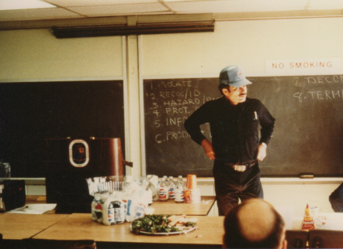
“Good leaders simply never act as important as they really are.”
8-STEP PROCESS CIRCA 1987

Slide 5
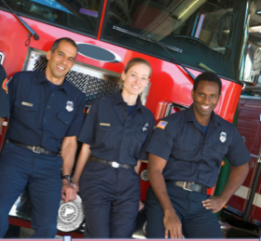
Firefighters and Police Officers are different… WHY?
Have you ever thought
about why you are
different from other people?

Slide 6
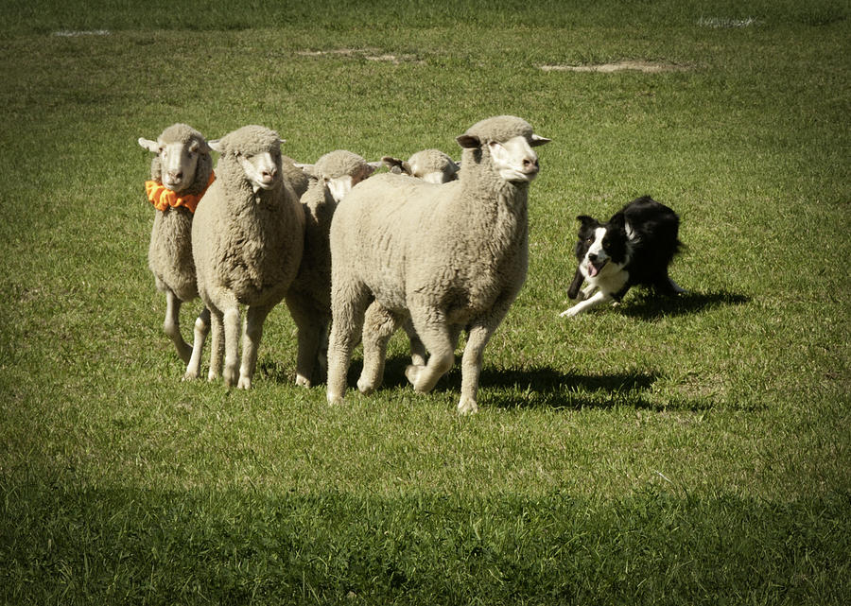
Why are you different?
Sheep, Wolves, and Sheepdogs. Which one are you?
Notes:
Quick audience survey and show of hands for the following questions…
Have you ever been on fire before?
Has anyone ever pulled a knife or gun on you?
Did you ever think an MRE could taste so good?
Did you every think your heart was going to explode?
When you are in a restaurant, do you visualize a fire in the restaurant and look for the exits, while your family sees the nice table setting and the décor?
The world is pretty complicated, but if you reduce it to simplicity, the world is made up of wolves, sheep, and sheepdogs. You are the sheepdogs!

Slide 7
ARE YOU DIFFERENT?
Have you ever been on fire before?
Has anyone ever pulled a knife or gun on you?
Did you ever think an MRE could taste so good?
Have you ever thought your heart was going to
explode?
Do you see a potential fire in the restaurant
while your family sees the nice table setting?

Slide 8
Wisdom from Successful Leaders
Each recipient of YLD funds provides the Foundation with an essay on leadership.
That’s 29 years of leadership wisdom, and it got us thinking…what are the top attributes of fire service leaders from the perspective of other fire service leaders?
We analyzed 92 award recipients’ leadership essays and six central concepts emerged. Here is how they are in rank.

Slide 9
What do leaders think makes a good leader?
“If you are a good leader, people will follow you ..
... even if it is out of curiosity!”
Can this collection of wisdom from proven leaders – a quarter century’s worth – provide us with a formula for leadership success?
Notes:
The six attributes are (in order of how frequently they appear):
Respect
Integrity and Honesty
Humility
Fairness
Best Interest of the Team
Positive Role Model/Good Mentor

Slide 10
1
Respect
“Respect has to be earned.
To earn respect you have
to give it to others.”
Notes:
The definition of respect: To have a high opinion of someone.
Key attributes:
Dignity
Good Name
Honor
Prestige
Reputation

Slide 11
Respect
To have a high opinion of someone
Key Attributes
Dignity
Good Name
Honor
Prestige
Reputation

Slide 12
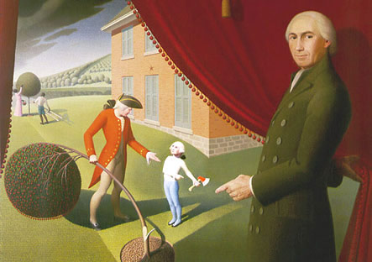
2
Integrity and Honesty
Notes:
Definition: To have moral or ethical strength.
Key Attributes:
Character
Fiber
Honesty
Principles

Slide 13
Integrity and Honesty
To have moral and ethical strength
Key Attributes
Character
Fiber
Honesty
Principle

Slide 14
3
Humility
Notes:
Definition: A lack of vanity of self-importance.
Key Attributes:
Humbleness
Modesty

Slide 15
Humility
Lack of vanity or self-importance
Key Attributes
Humbleness
Modesty
Willingness to admit you are wrong in a graceful way
Ability to take input from others

Slide 16
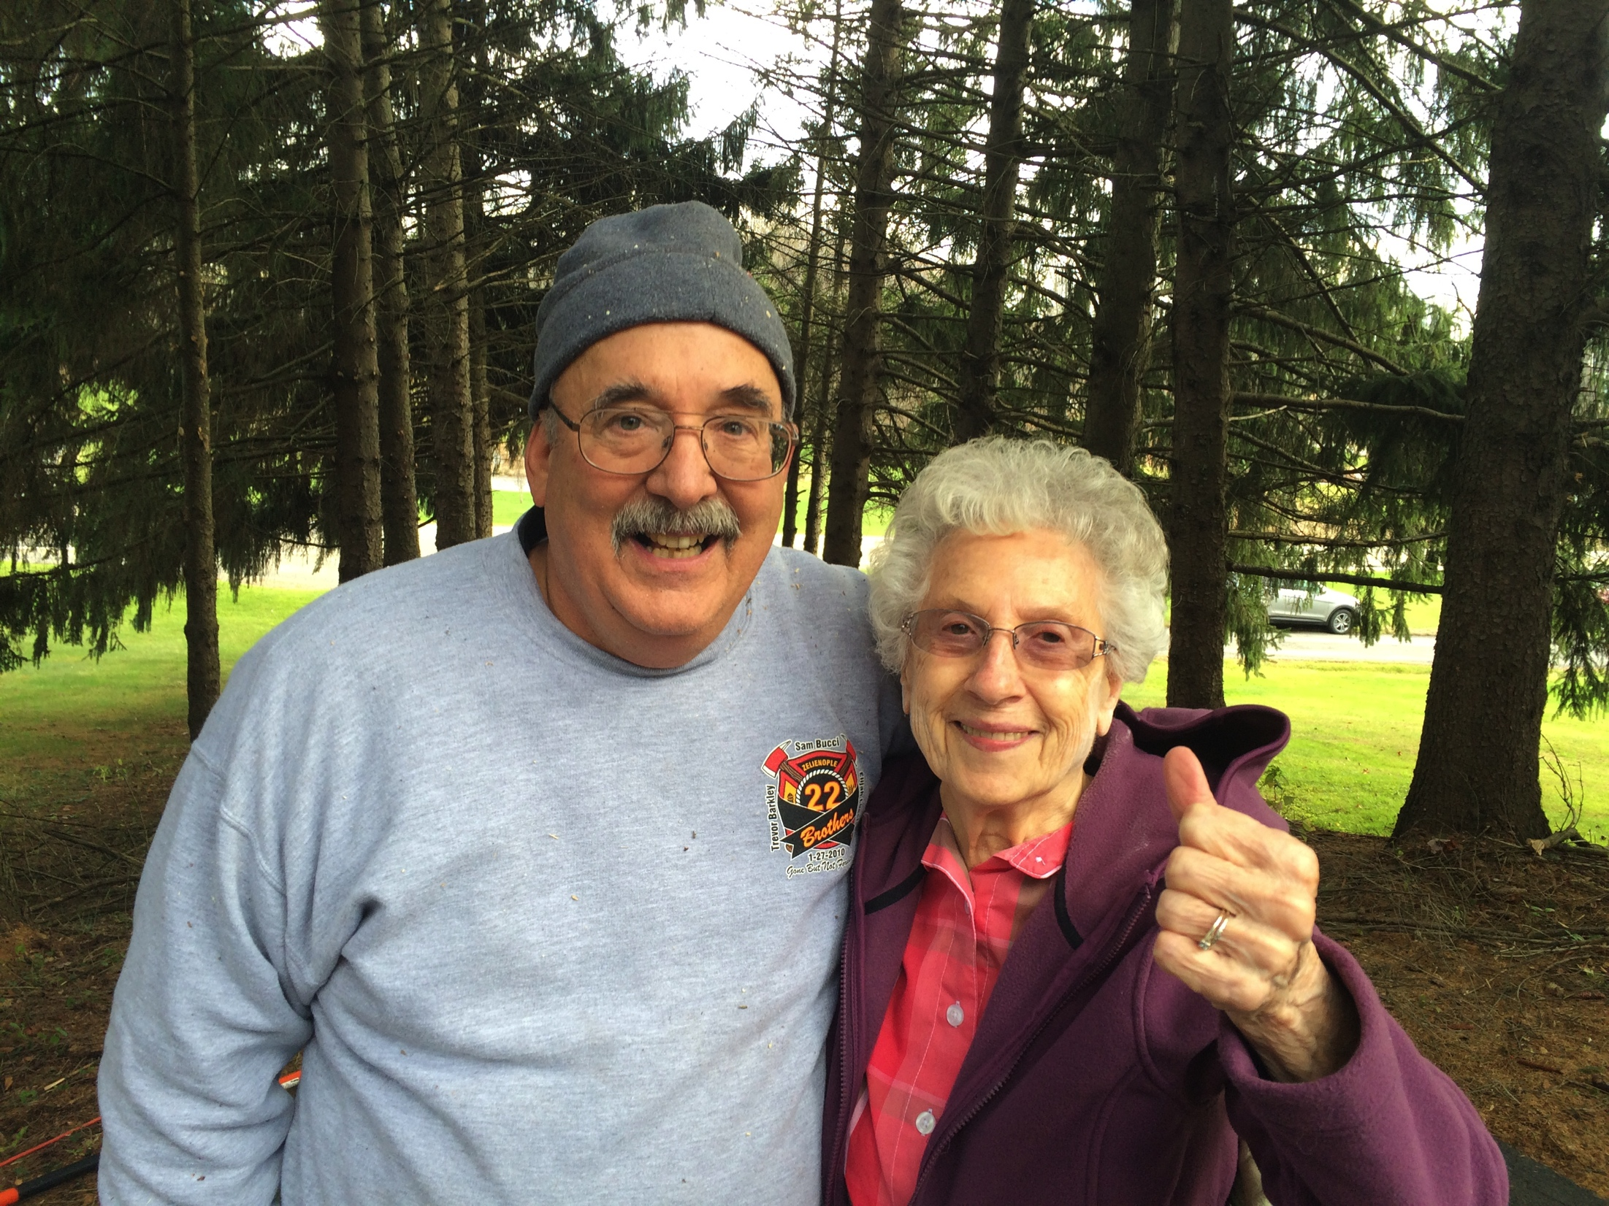
YLD Board Member Dr. James Zeigler and Mrs. Ruth Yvorra

Slide 17
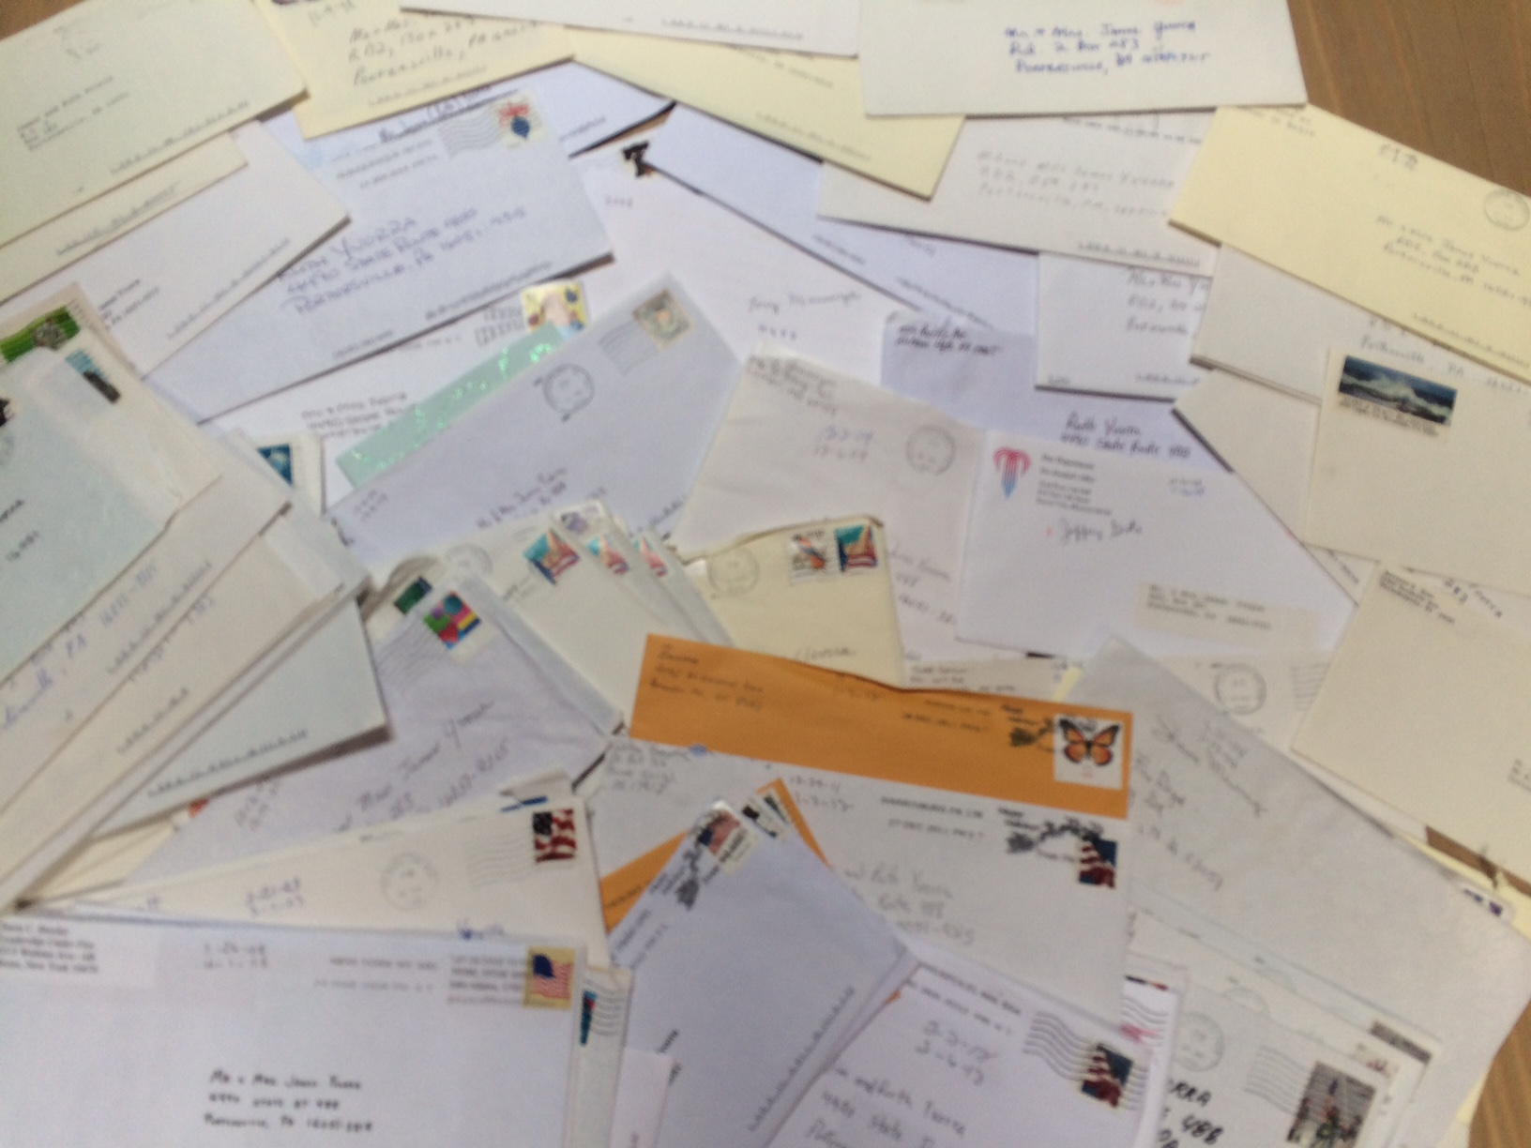
Letters of Humility To Mrs. Yvorra
from 92 YLD Award Recipients

Slide 18
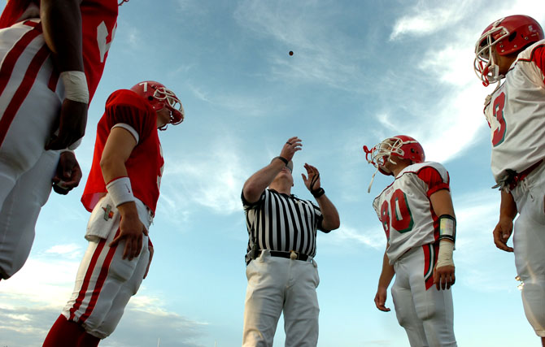
4
Fairness
Notes:
Definition: The quality of being fair and unbiased.
Key Attributes:
Impartiality
Justness
Objectivity

Slide 19
Fairness
“Being just and unbiased.”
Key Attributes
Impartiality
Justness
Objectivity

Slide 20
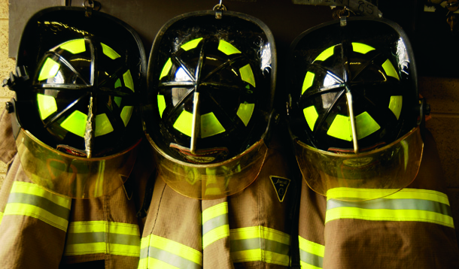
5
Putting the best interest of the group ahead of self interest
Notes:
Definition: Ability to make decisions that benefit and strengthen the entire team, not just a few team members.
Key Attributes:
Mentor
Motivate
Listening Skills

Slide 21
Service Before Self
Ability to make decisions that benefit and strengthen the entire team, not just a few
Key Attributes
Mentor
Motivate
Listen

Slide 22
MENTORING POINTS
Be dependable .... Be on Time
Be fit for duty
Be prepared for the job
Seek out extra duties
Don’t be afraid to fail
Seek out coaching and mentoring
Have Passion
“If you have passion for what you love and believe in,
success will come naturally.”

Slide 23
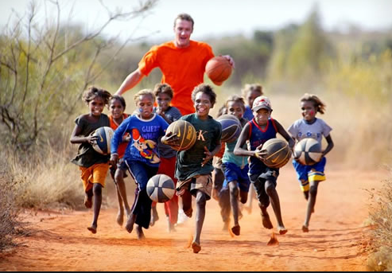
6
Positive role
model
Notes:
Definition: An individual that others look up to and respect.
Key Attributes:
Consistency
Passionate
Confident
Respected for his/her fire service knowledge and experience

Slide 24
Positive Role Model & Mentor
An individual that others look up to
Key Attributes
Consistent
Passionate
Confident
Ethical
Respected for knowledge
and experience

Slide 27
The journey to become a good leader has a price. But it can be very rewarding.
“Struggle and mistakes are
prerequisites for achieving
greatness.”

Slide 28
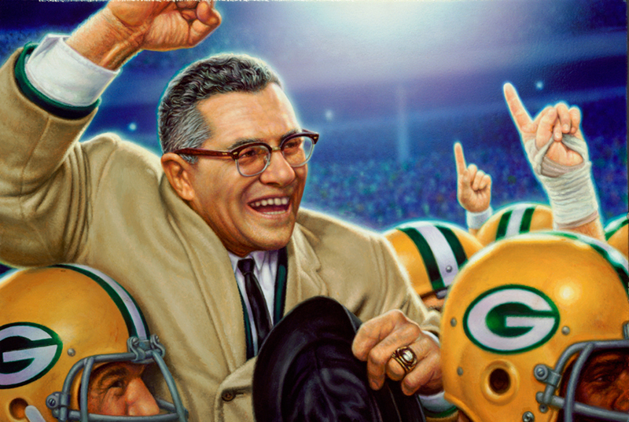
“Leaders aren’t born, they are made. And they are made just like anything else, through hard work. And that’s the price we’ll have to pay to achieve that goal, or any goal.”
-- Coach Vince Lombardi

Slide 29
www.yld.org

